Slide 1

Python for QA
Introduction

Slide 2
Expectations
Automate daily routine tasks by writing reusable scripts using Python
Pros:
Learn Python basics
Discover Python ecosystem
Explore new tools
Implement scripts
Try yourself as a programmer
Cons:
In depth understanding
D1 level in Python

Slide 3
Course Structure
8 lectures for approximately 1 hour
additional sessions on demand
home tasks with 3 levels
final exam and project
mentoring
Recommendations: start any other Python tutorial
Google's Python Class
vkhoroz/python-training
Notes:
https://github.com/vkhoroz/python-training
https://developers.google.com/edu/python/

Slide 4
Agenda
Intro to Python
Python basics
Data types
Control flows
Functions
Python intermediate
Files
Regular expressions
Import
Working with web services, JSON and XML
Databases
Data science tools

Slide 5
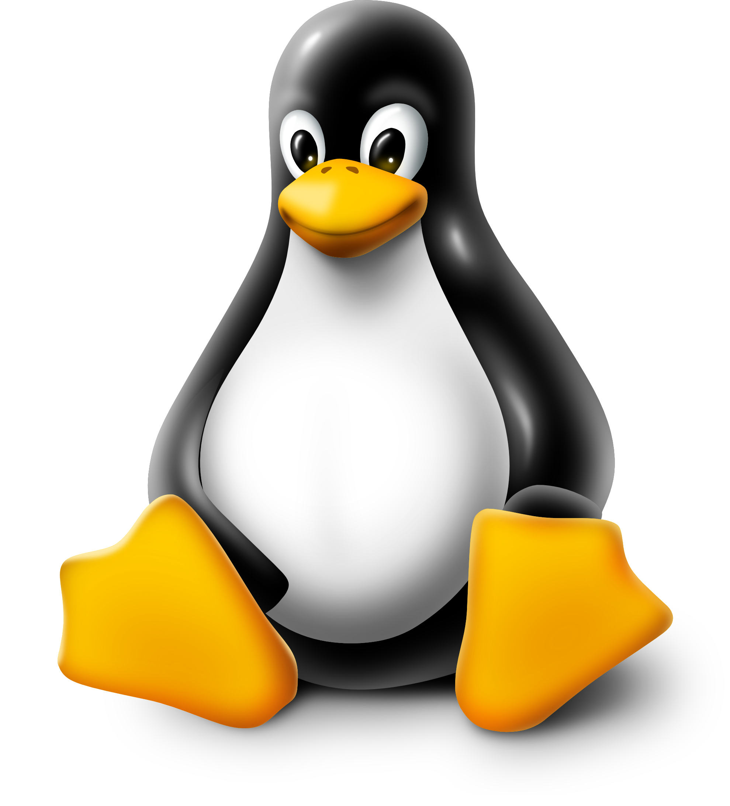
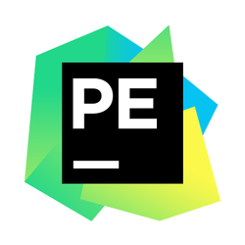

Working Environment

Slide 6
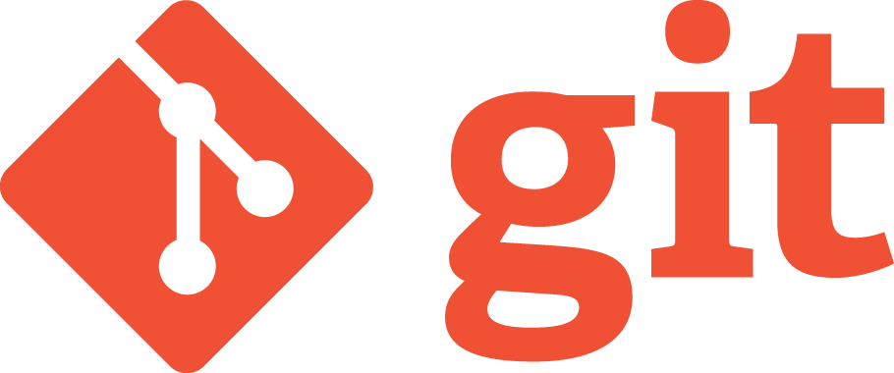
Practice
Notes:
Are we going to use pull requests?

Slide 7
Homework
Install VirtualBox
Run Ubuntu virtual machine
GitHub
Create account
Setup access
Create new repository
Practice with Git
Complete Git tutorial
Initialise local git repository
Create directories structure for homeworks
Add README file
Push changes to GitHub
Install PyCharm
Notes:
https://github.com/yrunts/python-for-qa/blob/master/0-course-introduction/homework.rst

Slide 8
Questions?

Slide 9
Good Luck

